Slide 1
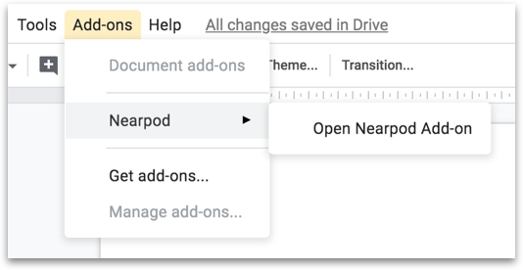
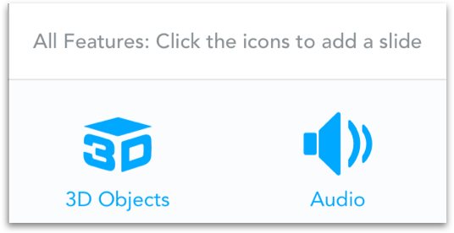
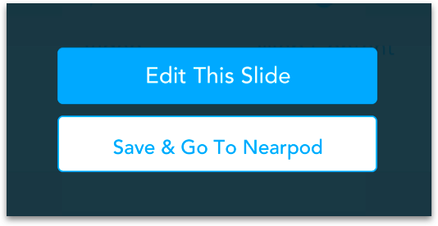
Using this template
This template is designed to be used with Nearpod’s Google Slides add-on! You can create your slides and add your favorite Nearpod activities and features, all within Google Slides.
If you haven’t used this feature before, follow these directions to learn how to create your Nearpod lesson within Google Slides.
Here’s how it works...
1. Install the Nearpod Add-On
2. Add Interactivity with Nearpod
3. Save & Go To Nearpod

